Slide 1
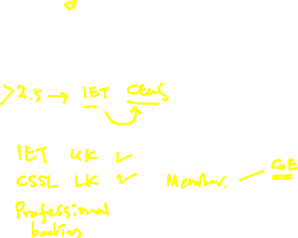
Computing Landscape
Prof. Koliya Pulasinghe

Slide 2
Aim of the Lecture
You will be a professional who works in an area related to Computing
Be effective by knowing the Landscape of your domain
How and in Which ways your profession impacts the society

Slide 3
Agenda
History of Computers
Today’s Computing Landscape
Social, Legal, Ethical and Environmental Aspects
Discussion

Slide 4
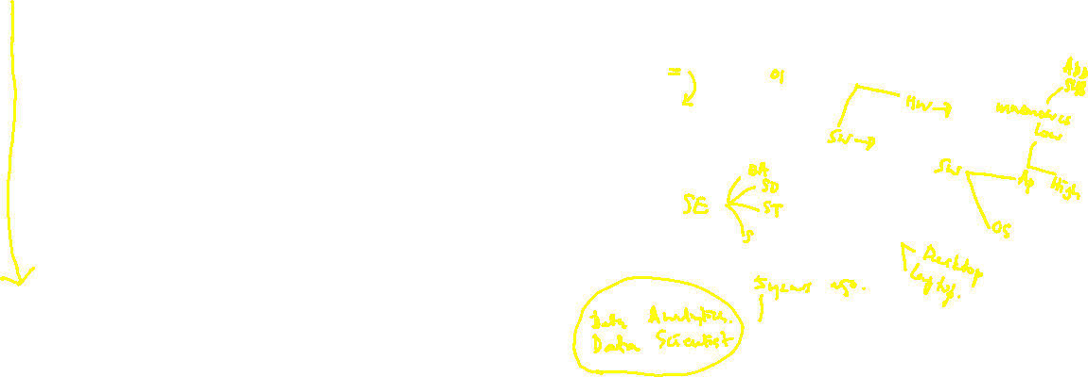
History of Computers
Pre-Generation (Before ‘40s) – Mechanical
First Generation (‘40s) – Vacuum Tube
Second Generation (‘50s) – Transistor
Third Generation (‘60s) – Integrated Circuits
Fourth Generation (‘70s) – Micro-processors
Fifth Generation (‘00) – AI

Slide 5
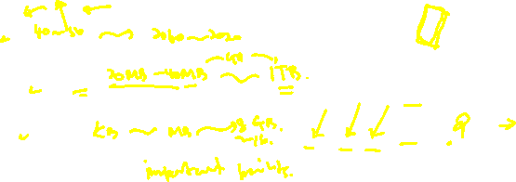
History of Computers
Rapid advancement
Components
CPUs
Hard Disk
Memory
IO Devices

Slide 6
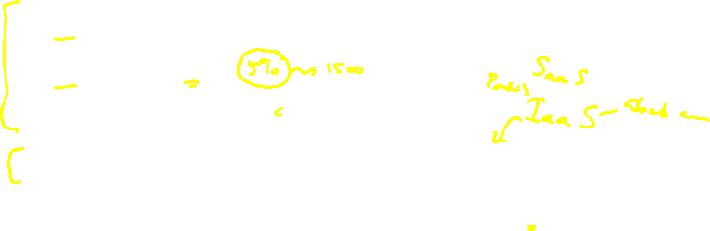
History of Computers
Rapid advancement
Computers
PCs, Workstations, Play stations
Notebooks
Hand held devices
Servers, Server farms and super computers
Embedded systems, wearable devices

Slide 7
Today’s Computing Landscape
Connectivity and Digital World
Internet
Mobile Phones
Emails
Social Networks
Online Education

Slide 8

Today’s Computing Landscape
Video sharing
Collaboration
E-commerce
Free information, Games etc.
Blogs
WWW

Slide 9

Areas of Concern in Current Computing Landscape
Ethical Issues
Legal Issues
Social Issues
Environmental Issues

Slide 10
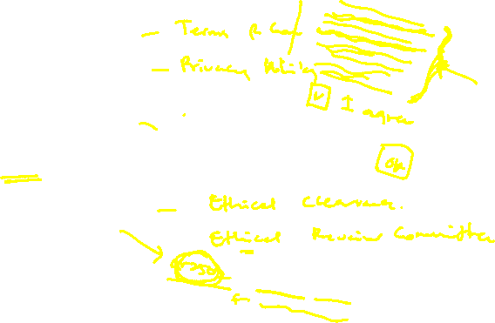
Ethical Issues
Intellectual Property
Information Collection
Spam
Differences between personal choices, business policies and Law

Slide 11

Legal Issues
Intellectual property and Licensing
Security vs privacy
Cyber crimes

Slide 12
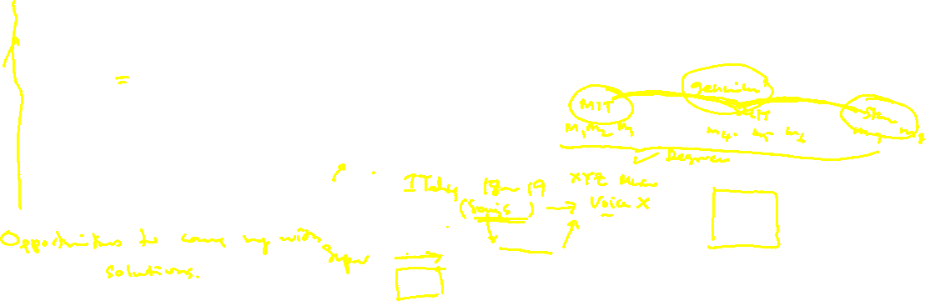
Social Issues
Outsourcing and unemployment
Digital divide and Massive Open Online Courseware (MOOC)
Computerized customer service
Increased possibility of identity theft
Social media related issues: Cyberbullying

Slide 13
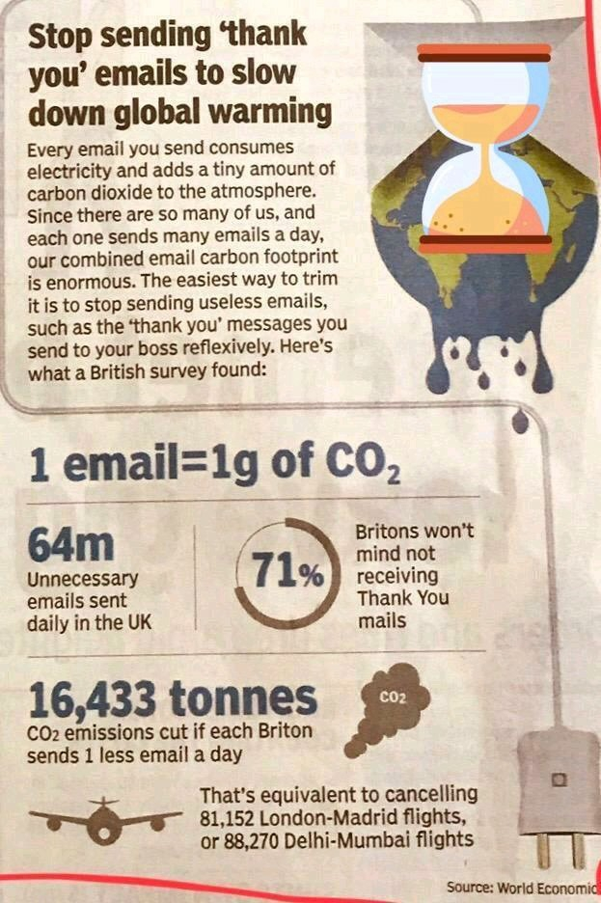

Environment Issues
E waste
Energy for manufacturing/operating
Hard copies of documents

Slide 14
Task 1: Critically evaluate following questions.
Some say that no technology is inherently good or evil; rather, any technology can be used for either good or evil purposes. Do you share this view?
“Thanks to a communications and software revolution, we are more ‘connected’ than ever before — by cell phone, email, and video conferencing — yet more disconnected than in the past from social interaction”. Do you agree?
What do you think are the main driving forces behind technology advances? Are you happy with the fast pace of the changes, or do you wish it were slower?
Do you tend to acquire new technological devices before or after the majority of your friends? What are the pros and cons of being an early/late adopter of a new technology?

Slide 15
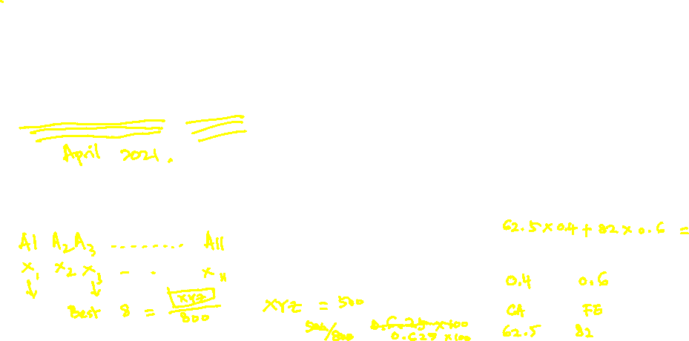
Assignment – Computing Landscape
Take one of your lifetime experience that resonates most with one of the four questions in the previous slide.
Write a reflective journal about that experience.
Submit your assignment as a PDF on or before midnight 27th September, 2020.

